Slide 1
The effectiveness of Music on Mental Illness: Depression and Anxiety
-Project 3-
Titus Muchiri, Richard Willet, Denise Miller
09-19-2024

Slide 2
Introduction
Agenda
The project covers the following
1. Project objectives
2. Methodology
3. Data analysis
4. Key insights
5. Recommendations

Slide 3
Intro
Source:
Public Domain: Kaggle: Music and Mental Health Survery Results
Data Size:
33 Columns
736 rows
Variables:
Age
Frequency of Play per Genre
# of “Yes” response to improvement to mental Health

Slide 5
Objective
To develop an interactive dashboard to visualize the effects assorted music genres have on anxiety, depression, OCD and insomnia.an interactive dashboard to visualize the effects assorted music genres have on Anxiety, Depression and Insomnia
The goal was to identify correlations between hours of music listening and anxiety, depression, and overall mental well-being scores

Slide 6
Introduction
Elevator Pitch
The project investigates the effects different music genres have on mental health, focusing on anxiety, depression, OCD and insomnia as key indicators.
By analyzing the relationship between hours of listening and mental health outcomes, we aim to uncover actionable insights for improving well-being through music

Slide 7
Music and the Muse
Rooted in the genes:
Cultural
Traditional
Comfort
Relaxation
TURN UP!!!!
While working:
Studying
Doing Menial tasks

Slide 8
What is….?
What is OCD?
Obsessive-compulsive Disorder
Uncontrolllable Thoughts and/or Engaging in Repetitive Behaviors.
What is Anxiety?
Persistent feeling of anxiety or dread
Triggered by situations, social environments and or phobias.
What is Insomnia?
Sleep Disorder
Trouble going and/or staying asleep resulting in no rest.

Slide 9
Music and Anxiety: The Visual
Richard Willet

Slide 10
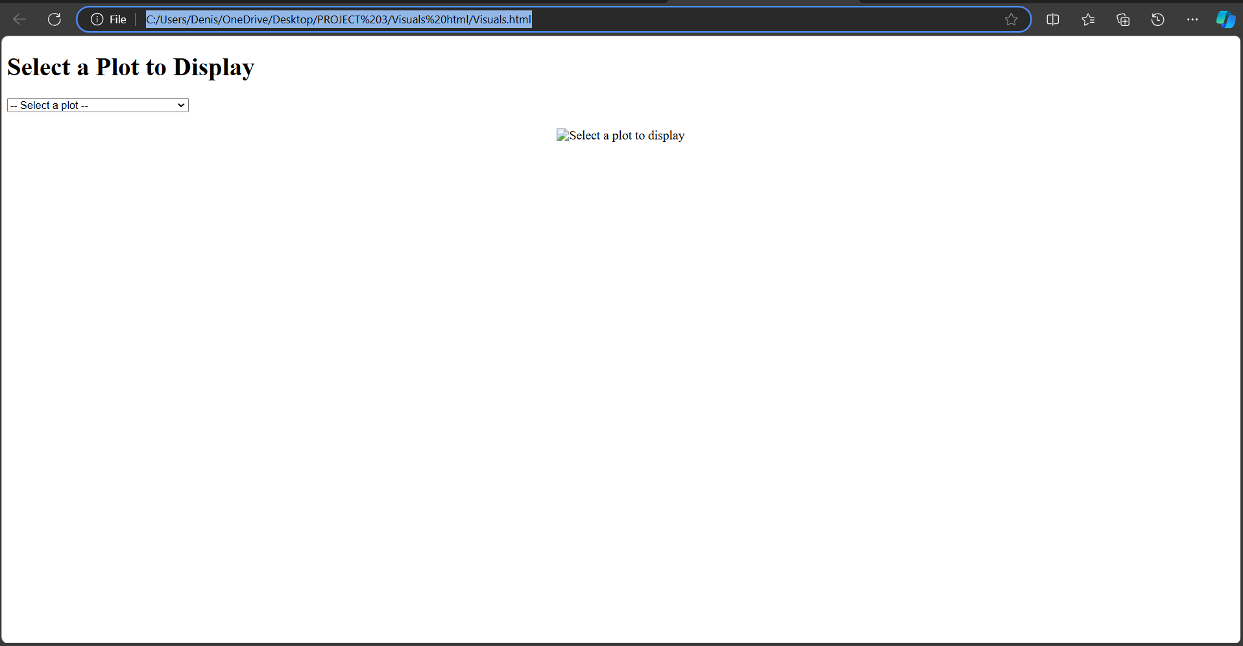
Where in the link are we?
HTML Visual

Slide 11
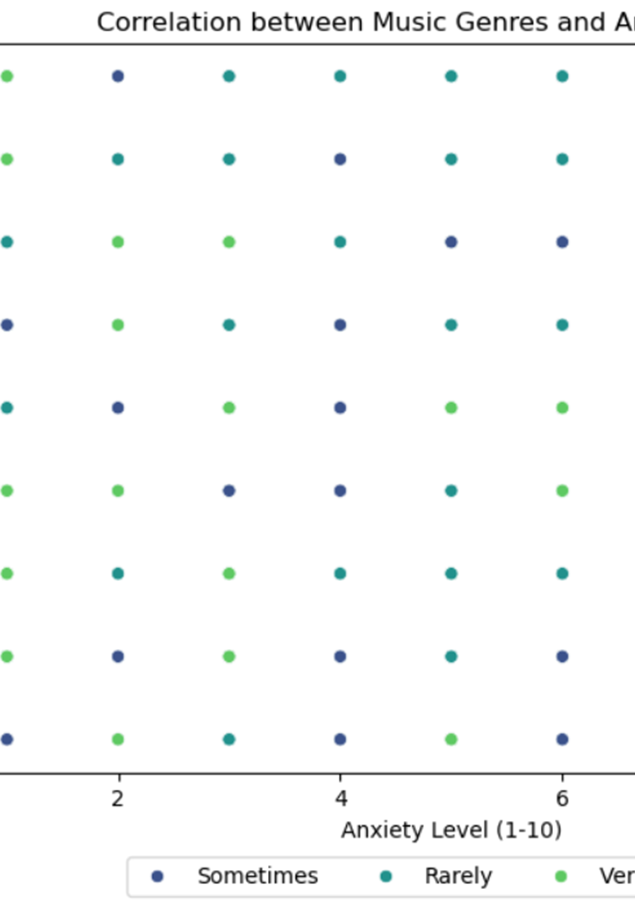
Anxiety level vs Genre
Top 3 Most listened to while:
Anxiety Level 7:
Pop
Rock
Classical
Anxiety Level 4:
Classical
Hip-Hop
Heavy Metal
Anxiety Level 0:
Hip-Hop
Folk
Metal

Slide 12
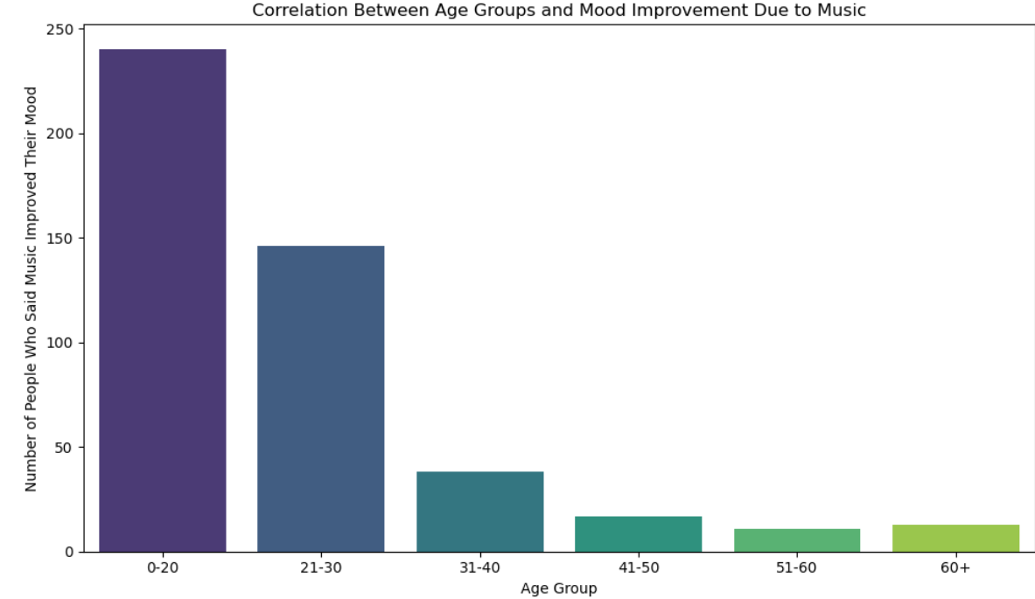
What say you?
Most improved based on age group:

Slide 13
Sum It Up
Music Therapy Success Factor:
Age
Music during daily activity
# Of Hours Played
Future Direction:
Correlate the Genre BPM, age, and mental illness
Are they musically inclined?
How often and how long is the person impacted by Mental Illness

Slide 14
Data Cleaning and Transformation
Denise Miller

Slide 15
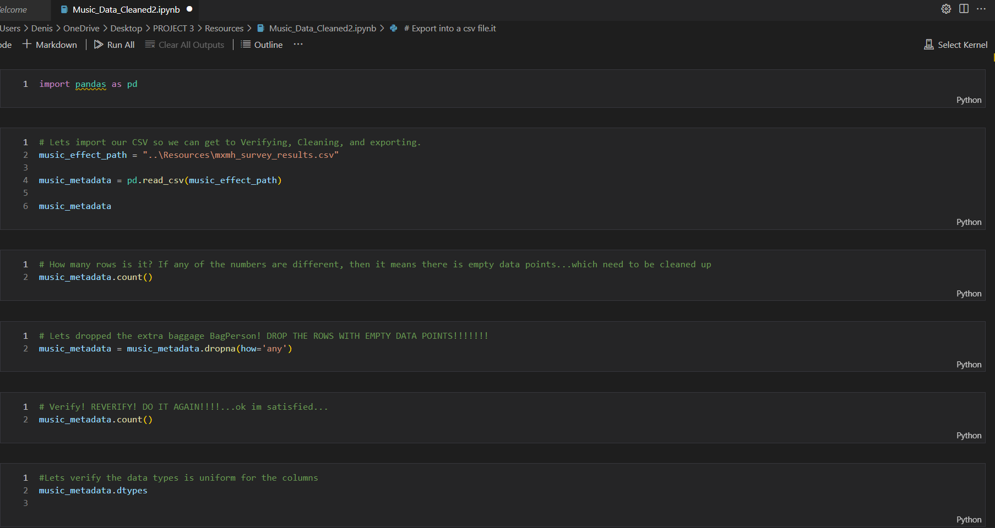
Step 1: Clean/Prepare
Import panda
Import Csv
Ensure no missing data: Row Count
Remove rows with missing data
Verify Data types
Export to a CSV file

Slide 16
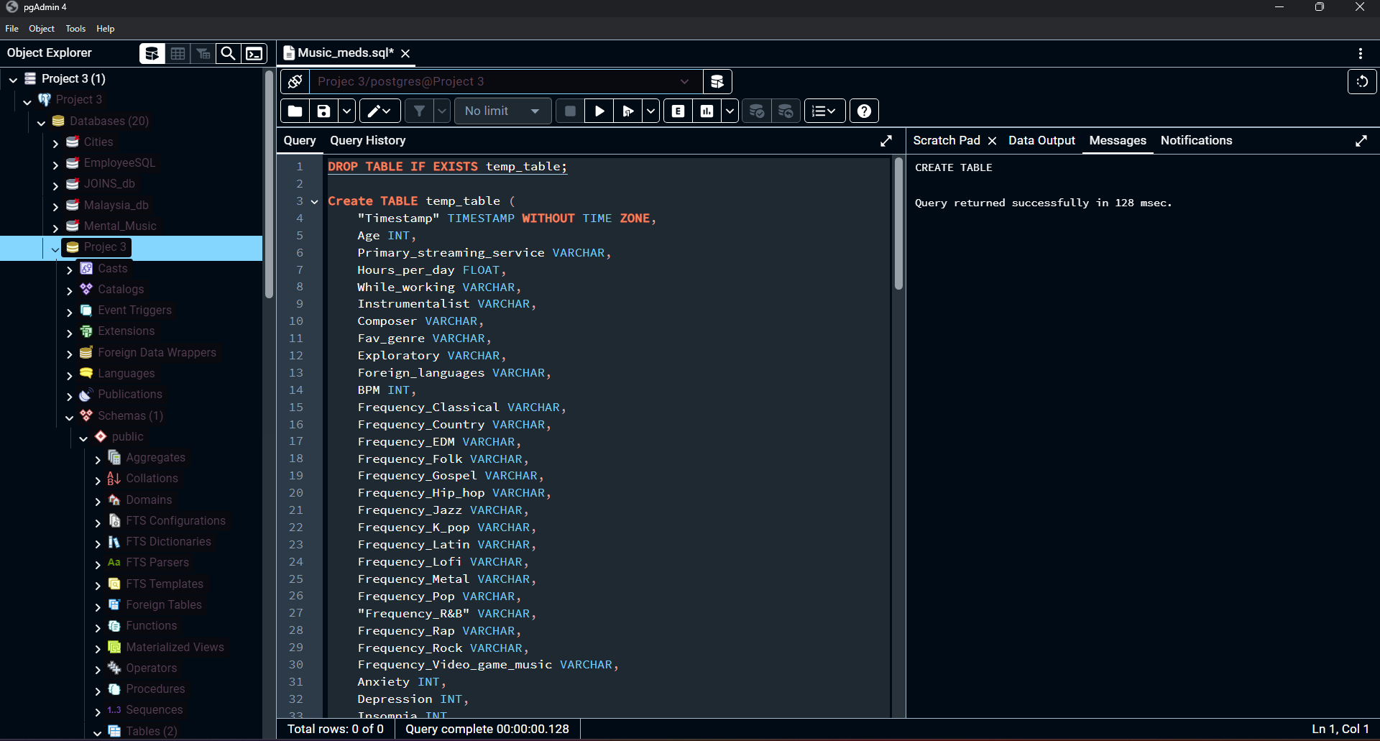
Step 2: Transform
Create Temp Table
Create new Table: less columns
Import cleaned data to new table
Export the table into a CSV file.

Slide 17
Visualization Path
Richard

Slide 18
Step 1:

Slide 19
Step 2:

Slide 20
Step 3:

Slide 21
Visualization Path
Titus Muchiri

Slide 22
Step 1:

Slide 23
Step 2:

Slide 24
Step 3:

Slide 25
Ethical Considerations
Privacy and confidentiality: data should be anonymized and secured.
Consent from participants ought to have been explicitly given to use their data for analysis.
Sensitivity to the stigma that accompanies mental health issues should ensure proper language is applied in the process.
Be careful not to present listening to music as a cure for mental health.
To be responsible using the data: Make sure no unintended harm can be caused by the conclusions in the analysis.

Slide 26
End Credits/Resources
Kaggle
National Library of Medicine
National Heart, Lung, and Blood Institute
National Institute of Mental Health

